Slide 1
ANY vs. ALL Subqueries:
Understanding the differences between ANY and ALL subqueries in SQL

Slide 2
What is “ALL”
ALL operator is used to select all tuples of SELECT STATEMENT. It is also used to compare a value to every value in another value set or result from a subquery
The ALL operator returns TRUE if all of the subqueries values meet the condition. The ALL must be preceded by comparison operators and evaluates true if all of the subqueries values meet the condition
ALL is used with SELECT, WHERE, HAVING statement.

Slide 3
ALL with SELECT Statement:
Syntax 1:
SELECT ALL field_name
FROM table_name
WHERE condition(s);
ALL with WHERE or HAVING Statement:
Syntax 2:
SELECT column_name(s)
FROM table_name
WHERE column_name comparison_operator ALL
(SELECT column_name
FROM table_name
WHERE condition(s));

Slide 4
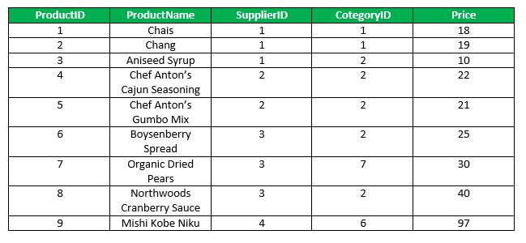
Example: Consider the following Products Table and Order Details Table ,Products Table
PRODUCT TABLE

Slide 5
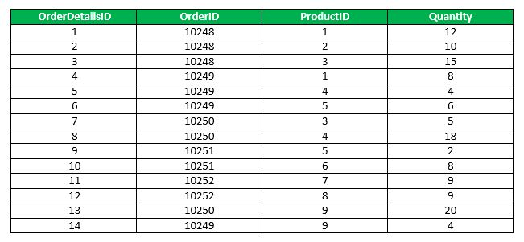
ORDERDETAILS TABLE
OrderDetails Table

Slide 6
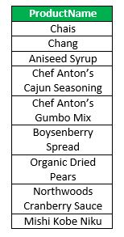
QUERY 1: .
:
Find the name of the all the product
SELECT ALL ProductName
FROM Products
WHERE TRUE;
OUTPUT

Slide 7

QUERY 2
Find the name of the product if all the records in the OrderDetails has Quantity either equal to 6 or 2.
SELECT ProductName
FROM Products
WHERE ProductID = ALL (SELECT ProductId
FROM OrderDetails
WHERE Quantity = 6 OR Quantity = 2);
OUTPUT:

Slide 8
WHAT IS “ANY”
ANY compares a value to each value in a list or results from a query and evaluates to true if the result of an inner query contains at least one row.
ANY return true if any of the subqueries values meet the condition.
ANY must be preceded by comparison operators.

Slide 9
Syntex
SELECT column_name(s)
FROM table_name
WHERE column_name comparison_operator ANY
(SELECT column_name
FROM table_name
WHERE condition(s));

Slide 10
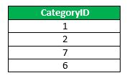
Query 1:
Find the Distinct CategoryID of the products which have any record in OrderDetails Table.
SELECT DISTINCT CategoryID
FROM Products
WHERE ProductID = ANY (SELECT ProductID
FROM OrderDetails);
OUTPUT:

Slide 11
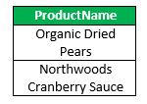
Query 2 :
Finds any records in the OrderDetails table that Quantity = 9.
SELECT ProductName
FROM Products
WHERE ProductID = ANY (SELECT ProductID
FROM OrderDetails
WHERE Quantity = 9);
OUTPUT :

Slide 12
Summary
The SQL ANY and ALL Operators
The ANY and ALL operators allow you to perform a comparison between a single column value and a range of other values.
ANY
ANY means that the condition will be true if the operation is true for any of the values in the range.
ALL
ALL means that the condition will be true only if the operation is true for all values in the range

